Slide 1
Programming with Shared Memory
Nguyễn Quang Hùng

Slide 2
Outline
Introduction
Constructs for specifying parallelism
  Creating concurrent processes
  Threads
Sharing data
  Creating shared data
  Accessing shared data
  Language constructs for parallelism
  Dependency analysis
  Shared data in systems with caches
Examples
  Pthreads example
Exercises

Slide 3
Introduction
Programming mainly discusses on:
  Multi-processes: Unix/Linux fork(), wait()…
  Multithreads: IEEE Pthreads…

Slide 4
Multiprocessor system
Multiprocessor systems: two types
  Shared memory multiprocessor.
  Message-passing multicomputer.
  In “Parallel programming:Techniques & applications using networked workstations & parallel computing” book.
Shared memory multiprocessor:
  SMP-based architecture: IBM RS/6000, Big BLUE/Gene supercomputer, etc.
Read more & report:
  IBM RS/6000 machine.
  http://www-1.ibm.com/servers/eserver/pseries/hardware/whitepapers/power4.html
  http://docs.hp.com/en/B6056-96002/ch01s01.html

Slide 5
Shared memory multiprocessor system
Any memory location can be accessible by any of the processors.
A single address space exists, meaning that each memory location is given a unique address within a single range of addresses.
Generally, shared memory programming more convenient although it does require access to shared data to be controlled by the programmer (using critical sections: semaphore, lock, monitor…).

Slide 6
Shared memory multiprocessor using a single bus
BUS
Cache
........
........
Processors
Memory modules
A small number of processors. Perhaps, Up to 8 processors.
Bus is used by one processor at a time. Bus contention increases by #processors.

Slide 7
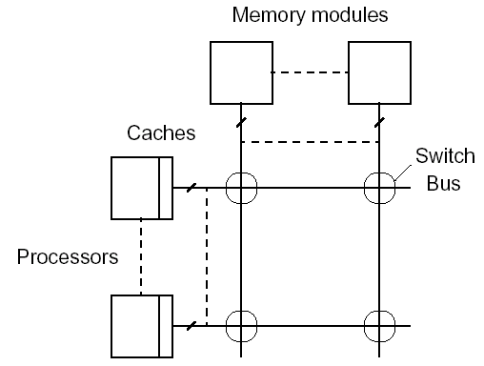
Shared memory multiprocessor using a crossbar switch

Slide 8
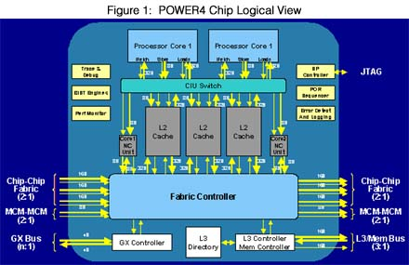
IBM POWER4 Chip logical view
Source: www.ibm.com

Slide 9
Several alternatives for programming shared memory multiprocessors
Using library routines with an existing sequential programming language.
  Multiprocesses programming:
    fork(), execv()…
  Multithread programming:
    IEEE Pthreads library
    Java Thread. http://java.sun.com
Using a completely new programming language for parallel programming - not popular.
  High Performance Fortran, Fortran M, Compositional C++….
Modifying the syntax of an existing sequential programming language to create a parallel programming language. Using an existing sequential programming language supplemented with compiler directives for specifying parallelism.
  OpenMP. http://www.openmp.org

Slide 10
Multi-processes programming
Operating systems often based upon notion of a process.
Processor time shares between processes, switching from one process to another. Might occur at regular intervals or when an active process becomes delayed.
Offers opportunity to de-schedule processes blocked from proceeding for some reasons, e.g. waiting for an I/O operation to complete.
Concept could be used for parallel programming. Not much used because of overhead but fork/join concepts used elsewhere.

Slide 11
FORK-JOIN construct
Main program
FORK
Spawned processes
FORK
FORK
JOIN
JOIN
JOIN
JOIN

Slide 12
UNIX System Calls
No join routine - use exit() and wait()
SPMD model
  ..
  pid = fork(); /* fork */
  Code to be executed by both child and parent
  if (pid == 0) exit(0); else wait(0); /* join */
  ...

Slide 13
UNIX System Calls (2)
SPMD model: master-workers model.
    …
    pid = fork();
    if (pid == 0) {
    Code to be executed by slave process
    } else {
    Code to be executed by master process
    }
    if (pid == 0) exit(0); else wait(0);
    ...

Slide 14
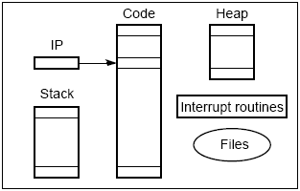
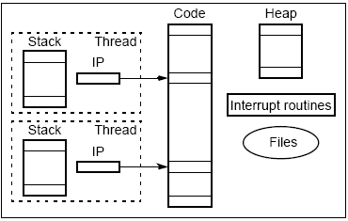
Process vs thread
Process
- Completely separate program with its own variables, stack, and memory allocation.
Threads
– Share the same memory space and global variables between routines

Slide 15
Thread
Light-weight processes
Shared components
  Global memory
  Instructions
  Most data
  Open descriptors (files, sockets etc)
  Signal handlers
Not shared
  Registers, Program counter, stack pointer
  Thread ID
  Stack
  Errno
  Priority

Slide 16
Thread (cont’d)
Each process can have multiple threads of concurrent control.
What’s wrong with processes?
  fork() is expensive
    10 to 100 times slower
    Copy of everything in parent.
  Inter process communication
    For returning information from child to parent

Slide 17
Advantages of Threads
Light-weight
  Lower Context Switching Overhead
  Fewer OS resources
Shared State
  Don’t need IPC-like mechanism to communicate between threads of same process

Slide 18
Disadvantages of Threads
Shared State!
  Global variables are shared between threads. Accidental changes can be fatal.
Many library functions are not thread-safe
  Library Functions that return pointers to static internal memory.
Lack of robustness
  Crash in one thread will crash the entire process.

Slide 19
IEEE Pthreads (1)
IEEE Portable Operating System Interface, POSIX, sec. 1003.1 standard
Executing a Pthread thread
Main program
Thread1
proc1( &arg )
{
….
return( *status );
}
pthread_create( &thread, NULL, proc1, &arg );
Pthread_join( thread1, *status);

Slide 20
The pthread_create() function
#include <pthread.h>
int pthread_create(
pthread_t *threadid,
pthread_attr_t * attr,
void * (*start_routine)(void *),
void * arg);
The pthread_create() function creates a new thread storing an identifier to the new thread in the argument pointed to by threadid.

Slide 21
The pthread_join() function
#include <pthread.h>
void pthread_exit(void *retval);
int pthread_join(pthread_t threadid,
void **retval);
The function pthread_join() is used to suspend the current thread until the thread specified by threadid terminates. The other thread’s return value will be stored into the address pointed to by retval if this value is not NULL.

Slide 22
Detached threads
It may be that threads are not bothered when a thread it creates terminates and then a join not needed.
Threads not joined are called detached threads.
When detached threads terminate, they are destroyed and their resource released.

Slide 23
Pthread detached threads
Main program
Parameter (attribute) specifies a detached thread
pthread_create()
Thread
pthread_create()
Thread
Termination
pthread_create()
Thread
Termination
Termination

Slide 24
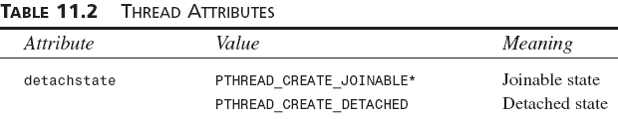
The pthread_detach() function
#include <pthread.h>
int pthread_detach(pthread_t threadid);
Put a running thread into detached state.
Can’t synchronize on termination of thread threadid using pthread_join().

Slide 25
Thread cancellation
#include <pthread.h>
int pthread_cancel(pthread_t thread);
int pthread_setcancelstate(int state, int *oldstate);
int pthread_setcanceltype(int type, int *oldtype);
void pthread_testcancel(void);
The pthread_cancel function allows the current thread to cancel another thread, identified by thread.
Cancellation is the mechanism by which a thread can terminate the execution of another thread. More precisely, a thread can send a cancellation request to another thread. Depending on its settings, the target thread can then either ignore the request, honor it immediately, or defer it till it reaches a cancellation point.

Slide 26
Other Pthreads functions
#include <pthread.h>
int pthread_atfork(void (*prepare)(void), void (*parent)(void), void (*child)(void));

Slide 27
Thread pools
Master-Workers Model:
  A master thread controls a collection of worker thread.
  Dynamic thread pools.
  Static thread pools.
  Threads can communicate through shared locations or signals.

Slide 28
Statement execution order
Single processor: Processes/threads typically executed until blocked.
Multiprocessor: Instructions of processes/threads interleaved in time.
Example
    Process 1 Process 2
    Instruction 1.1 Instruction 2.1
    Instruction 1.2 Instruction 2.2
    Instruction 1.3 Instruction 2.3
Several possible orderings, including
    Instruction 1.1
    Instruction 1.2
    Instruction 2.1
    Instruction 1.3
    Instruction 2.2
    Instruction 2.3
assuming instructions cannot be divided into smaller interruptible steps.

Slide 29
Statement execution order (2)
If two processes were to print messages, for example, the messages could appear in different orders depending upon the scheduling of processes calling the print routine.
Worse, the individual characters of each message could be interleaved if the machine instructions of instances of the print routine could be interleaved.

Slide 30
Compiler/Processor optimization
Compiler and processor reorder instructions for optimization.
Example: the statements
      a = b + 5;
      x = y + 4;
could be compiled to execute in reverse order:
      x = y + 4;
      a = b + 5;
and still be logically correct.
May be advantageous to delay statement a = b + 5 because a previous instruction currently being executed in processor needs more time to produce the value for b. Very common for processors to execute machines instructions out of order for increased speed .

Slide 31
Thread-safe routines
Thread safe if they can be called from multiple threads simultaneously and always produce correct results.
Standard I/O thread safe:
  printf(): prints messages without interleaving the characters.
NOT thread-safe functions:
  System routines that return time may not be thread safe.
Routines that access shared data may require special care to be made thread safe.

Slide 32
SHARING DATA

Slide 33
SHARING DATA
Every processor/thread can directly access shared variables, data structures rather than having to the pass data in messages.
Solution for critical sections:
  Lock
  Mutex
  Semaphore
  Conditional variables
  Monitor

Slide 34
Creating shared data
UNIX processes: each process has its own virtual address space within the virtual memory management system.
  Shared memory system calls allow processes to attach a segment of physical memory to their virtual memory space.
    shmget() – creates, returns shared memory segment identifier.
    shmat() – returns the starting address of data segment.
It’s NOT necessary to create shared data items explicity when using threads.
  Global variables: available to all threads.

Slide 35
Acsessing shared data
Accessing shared data needs careful control.
Consider two processes each of which is to add one to a shared data item, x. Necessary for the contents of the location x to be read, x + 1 computed, and the result written back to the location:
Instruction Process 1 Process 2
x = x + 1; read x read x
compute x + 1 compute x + 1
write to x write to x
Time

Slide 36
Conflict in accessing shared variable
Shared variable, x
write
write
read
read
+1
+1
Process 1
Process 2

Slide 37
Critical section
A mechanism for ensuring that only one process accesses a particular resource at a time is to establish sections of code involving the resource as so-called critical sections and arrange that only one such critical section is executed at a time
This mechanism is known as mutual exclusion.
This concept also appears in an operating systems.

Slide 38
Locks
Simplest mechanism for ensuring mutual exclusion of critical sections.
A lock is a 1-bit variable that is a 1 to indicate that a process has entered the critical section and a 0 to indicate that no process is in the critical section.
Operates much like that of a door lock:
  A process coming to the “door” of a critical section and finding it open may enter the critical section, locking the door behind it to prevent other processes from entering. Once the process has finished the critical section, it unlocks the door and leaves.

Slide 39
Control of critical sections through busy waiting
Processs 1 Process 2
while (lock == 1) do_nothing;
lock = 1;
Critical section
Lock = 0;
while (lock == 1) do_nothing;
lock = 1;
Critical section
Lock = 0;

Slide 40
Pthreads lock functions
Pthreads implements lock by mutally exclusive lock variables (mutex variables).
pthread_mutex_t mutex1;
pthread_mutex_init( &mutex1, NULL );
……..
pthread_mutex_lock ( &mutex1 );
/// Critical section code here
pthread_mutex_unlock( &mutex1 );
Only 1 thread can enter the critical section code or wait
Only the thread that locks a mutex can unlock it. Otherwise, throws an error.

Slide 41
IEEE Pthreads example
Calculating sum of an array a[ ].
N threads created, each taking numbers from list to add to their sums. When all numbers taken, threads can add their partial results to a shared location sum.
The shared location global_index is used by each thread to select the next element of a[].
After index is read, it is incremented in preparation for the next element to be read. The result location is sum, as before, and will also need to be shared and access protected by a lock.

Slide 42
IEEE Pthreads example (2)
Calculating sum of an array a[ ].
global_index
sum
Array a[ ]
…………………………………………..
addr
Code at page 254

Slide 43
IEEE Pthreads example (3)
#include <stdio.h>
#include <pthread.h>
#define ARRAY_SIZE 1000
#define NUM_THREADS 10
// Global Variables, Shared data
int a[ ARRAY_SIZE ];
int global_index = 0;
int sum = 0;
pthread_mutex_t mutex1; // mutually exclusive lock variable
pthread_t worker_threads[ NUM_THREADS ];

Slide 44
IEEE Pthreads example (4)
// Worker thread
void *worker(void *ignored ) {
int local_index, partial_sum = 0;
do {
pthread_mutex_lock ( &mutex1 );
local_index = global_index; global_index++;
pthread_mutex_unlock( &mutex1 );
if (local_index < ARRAY_SIZE) {
partial_sum += a [ local_index ];
}
}
while ( local_index < ARRAY_SIZE );
pthread_mutex_lock( &mutex1 );
sum += partial_sum;
pthread_mutex_unlock( &mutex1 );
}

Slide 45
IEEE Pthreads example (5)
void master() {
int i;
// Initialize mutex
pthread_mutex_init( &mutex1, NULL );
init_data();
create_workers( NUM_THREADS );
// Join threads
for (i = 0; i < NUM_THREADS ; i++ ) {
if ( pthread_join( worker_threads[i], NULL ) != 0 ) {
perror( "PThread join fails" );
}
}
printf("The sum of 1 to %i is %d \n" , ARRAY_SIZE, sum );
}

Slide 46
IEEE Pthreads example (6)
void init_data() {
int i;
for (i = 0; i < ARRAY_SIZE ; i++ ) { a[i] = i + 1; }
}
// Create some worker threads
void create_workers(int n){
int i;
for (i = 0; i < n ; i++ ) {
if (pthread_create(&worker_threads[i], NULL,
worker, NULL ) != 0 ) {
perror( "Pthreads create fails" ); }
}
}

Slide 47
Java multithread programming
A class extends from java.lang.Thread class.
A class implements java.lang.Runnable interface.
// A sample Runner class
public class Runner extends Thread
{
String name;
public Runner(String name) {
this.name = name;
}
public void run() {
int N = 10;
for (int i = 0; i < N ; i++) {
System.out.println("I am "+
this.name + "runner at “ + I + “ km.");
thread.delay(100);
}
}
public static void main(String[] args)
{
Runner hung = new Runner("Hung");
Runner minh = new Runner("Minh");
Runner ken = new Runner(“Ken");
hung.start();
minh.start();
ken.start();
System.out.println("Hello World!");
}
} // End main

Slide 48
Language Constructs for Parallelism

Slide 49
Language Constructs for Parallelism - Shared Data
Shared Data:
  shared memory variables might be declared as shared with, say,
shared int x;
Par Construct
  par {
        S1;
        S2;
        .
        .
        Sn;
  }
par {
proc1();
proc2();
…
}

Slide 50
Forall Construct
Keywords: forall or parfor
To start multiple similar processes together: which generates n processes each consisting of the statements forming the body of the for loop, S1, S2, …, Sm. Each process uses a different value of i.
forall (i = 0 ; i < N; i++ ) {
S1;
S2;
…..
Sm;
}
Example:
      forall (i = 0; i < 5; i++)
        a[i] = 0;
clears a[0], a[1], a[2], a[3], and a[4] to zero concurrently.

Slide 51
Dependency analysis
To identify which processes could be executed together.
Example: can see immediately in the code
      forall (i = 0; i < 5; i++)
      a[i] = 0;
that every instance of the body is independent of other instances and all instances can be executed simultaneously.
However, it may not be that obvious. Need algorithmic way of recognizing dependencies, for a parallelizing compiler.

Slide 52
Bernstein's Conditions
Set of conditions sufficient to determine whether two processes can be executed simultaneously. Given:
  I_{i} is the set of memory locations read (input) by process P_{i}.
  O_{j} is the set of memory locations written (output) by process P_{j}.
For two processes P1 and P2 to be executed simultaneously, inputs to process P1 must not be part of outputs of P2, and inputs of P2 must not be part of outputs of P1; i.e.,
  I₁ ∩ O₂ = φ
  I₂ ∩ O₁ = φ
where f is an empty set. Set of outputs of each process must also be different; i.e.,
  O₁ ∩ O₂ = φ
If the three conditions are all satisfied, the two processes can be executed concurrently.

Slide 53
Example
Example: suppose the two statements are (in C)
  a = x + y;
  b = x + z;
We have
  I1 = (x, y) O1 = (a)
  I2 = (x, z) O2 = (b)
and the conditions
  I1 ∩ O2 = φ
  I2 ∩ O1 = φ
  O1 ∩ O2 = φ
are satisfied. Hence, the statements a = x + y and b = x + z can be executed simultaneously.

Slide 54
OpenMP
An accepted standard developed in the late 1990s by a group of industry specialists.
Consists of a small set of compiler directives, augmented with a small set of library routines and environment variables using the base language Fortran and C/C++.
The compiler directives can specify such things as the par and forall operations described previously.
Several OpenMP compilers available.
Exercise: read more & report:
  http://www.openmp.org

Slide 55
Shared Memory Programming Performance Issues
Shared data in systems with caches
  Cache coherence protocols
  False Sharing:
    Solution: compiler to alter the layout of the data stored in the main memory, separating data only altered by one processor into different blocks.
High performance programs should have as few as possible critical sections as their use can serialize the code.

Slide 56
Sequential Consistency
Formally defined by Lamport (1979):
  A multiprocessor is sequentially consistent if the result of any execution is the same as if the operations of all the processors were executed in some sequential order, and the operations of each individual processors occur in this sequence in the order specified by its program.
i.e. the overall effect of a parallel program is not changed by any arbitrary interleaving of instruction execution in time.

Slide 57
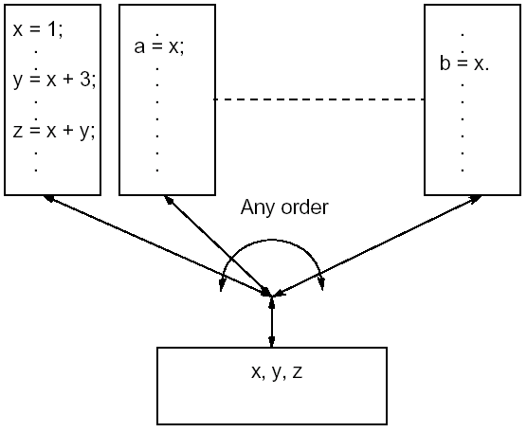
Sequential consistency
Processors (Programs)

Slide 58
Sequential consistency (2)
Writing a parallel program for a system which is known to be sequentially consistent enables us to reason about the result of the program. For example:
    Process P1 Process 2
    …
    data = new; .
    flag = TRUE; .
… . .
    while (flag != TRUE) { };
    data_copy = data;
    . .
    Expect data_copy to be set to new because we expect the statement data = new to be executed before flag = TRUE and the statement while (flag != TRUE) { } to be executed before data_copy = data. Ensures that process 2 reads new data from another process 1. Process 2 will simple wait for the new data to be produced.

